Slide 1




Module Name - Inheritance & Polymorphism
Class - Day 4
Topic Name- Polymorphism
EditEdit MasterMaster texttext stylesstyles

Slide 2
Time Allocation Summary
Element | Slide numbers | Maximum time allowed (min)
Today’s Agenda | 4-5
Spot Test | 6-7
Introduction to Polymorphism | 8-11
Method Overriding: Introduction Example | 12-19
Method Overriding | 20-22
Method Overriding: Consideration | 23-25
Method Overloading: Introduction Example | 26-28
Method Overloading | 29-32
Types of Polymorphism | 33
Static Polymorphism | 34-35
Introduction to Dynamic Polymorphism | 36-39
Dynamic Polymorphism | 40-44

Slide 3
Time Allocation Summary
Element | Slide numbers | Maximum time allowed (min)
Dynamic Polymorphism : Example | 45-52
Dynamic Polymorphism: Detailed Concept | 53-57
Need for Abstract Classes | 58-68
Introduction to Abstract Classes | 69-70
Abstract Classes | 71-73
Characteristics of Abstract Classes | 74-77
Abstract Class: Example | 78-79
Interface | 80-86
Interfaces vs Abstract Classes | 87-89
OOPs Convention | 90-92
Summary | 93-97
Total |  | 120

Slide 4
Today’s Agenda
Introduction to Dynamic Polymorphism
Characteristics of Dynamic Polymorphism
Detailed Example of Dynamic Polymorphism
Professor Example to understand Need for Abstract Classes
Introduction to Polymorphism
Types of Polymorphism

Slide 5
Today’s Agenda
Method Overriding & Method Overloading
Introduction to Abstract Classes
Characteristics of Abstract Classes
Interfaces
Difference between Interfaces and Abstract Classes
File Nomenclature according to OOPs Convention

Slide 6
Spot Test
What is the need for Inheritance?
Which keyword is used by a class to inherit another class?
What is constructor chaining?
What is multiple inheritance? Is it supported in Java?

Slide 7
Spot Test
Give some differences between Composition and Inheritance.
What is the role of Protected Access Modifier? Give example.
Can a subclass be again inherited by another class? If yes, show the syntax.
Which constructor will be called when an object of a subclass is created?

Slide 8
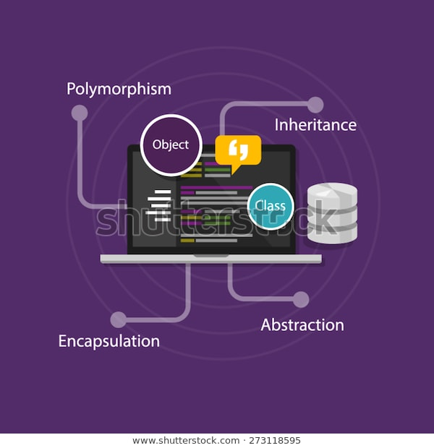
Introduction to Polymorphism
So far, you have seen the three principle of OOPs: Abstraction, Encapsulation & Inheritance.
Now, it's time to study about the last principle
of OOPs i.e Polymorphism.
Polymorphism is essentially a Greek term which
is derived from two Greek words - “Poly” meaning “many” & “morph” meaning “change in form”.

Slide 9
Introduction to Polymorphism
What is Polymorphism?
Polymorphism essentially means for something to occur in "different forms".
In the programming paradigm, it means the ability of a variable, function or object to take on multiple forms.

Slide 10
Introduction to Polymorphism
An example would be that many programming languages consider "integer", "float" and "double" as polymorphic forms of each other.
They are different data types but one can add/subtract and perform many other arithmetic operations on them.

Slide 11

Introduction to Polymorphism
The need for polymorphism
A language that incorporates
polymorphism allows developers to
program in a universal manner which can
be transformed and used in many
paradigms, rather than write a very
specific program which can only run in one scenario.

Slide 12

Method Overriding: Introduction Example
Now, you know that inheritance allows you to inherit methods from a superclass to a subclass without you having to redefine the same method again.
But, what if you need to use the same
method with an additional or modified
functionality for your subclass?
Method Overriding is used for this.

Slide 13

Method Overriding: Introduction Example
Let us start with an example. Suppose, you are not happy with the details that are printed for the Research Student when you implement ResearchStudent class as a subclass of the Student class.
In particular, Research Area is not getting
printed for a Research Student which is an
important attribute.

Slide 14
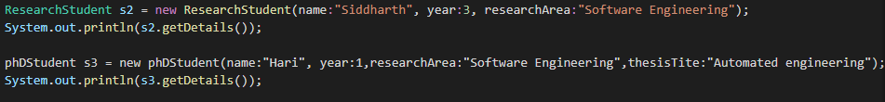
Method Overriding: Introduction Example
Here, Siddharth and Hari are two research students.
They have their own attributes specific to the research student as in both of them have researchArea parameter and hari
being a phd student has thesisTitle parameter as well.

Slide 15

Method Overriding: Introduction Example
However, these attributes are not being printed when you are printing the details using objects for Siddharth and Hari.
So, is it possible to have specific versions of
the getDetails() method implemented for
the ResearchStudent class and the
PhdStudent class?
Well, yes.

Slide 16
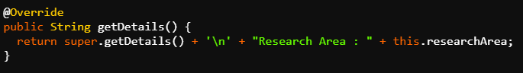
Method Overriding: Introduction Example
Let us see how you can implement a specific implementation of getDetails() method in the ResearchStudent class.
You’ll be defining another getDetails() method in the ResearchStudent class. You’ll be using the super keyword to implement all the properties and attributes of the super class getDetails() method inside this getDetails() method.

Slide 17

Method Overriding: Introduction Example
So, now this getDetails() is a method which is different from the getDetails() method in the Student class.
Now, what will happen when you’ll run the code?
You’ll observe that when you execute the code,
Research Area also gets printed for the
Research Student.

Slide 18
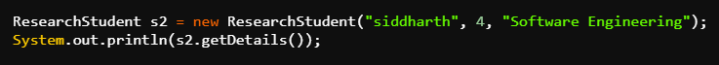
Method Overriding: Introduction Example
This means that you ended up executing specific implementation of the getDetails() method in the ResearchStudent class and not the getDetails() method in the Student class.
This will happen when you’ll call the getDetails method using s2 object as s2 is an object of the ResearchStudent class and that’s why the getDetails() method present in the ResearchStudent class will be called.

Slide 19

Method Overriding: Introduction Example
How did you succeed in invoking the getDetails() method of the ResearchStudent class when earlier you were invoking the getDetails() method of the Student class?
Well, this was possible because of the
phenomena known as Method Overriding.

Slide 20
Method Overriding
Method Overriding
Defining two or more methods with the same name and same signature.
One version of a method in a superclass and the other version in a subclass.
By default, whenever a call to the overridden method is made, the subclass version of the method is invoked.

Slide 21
Method Overriding
Note: Whenever a call to the overridden method is made, it is the subclass version of the method that is invoked and not the superclass version.
To call the superclass version of the overridden method, use the ‘super’ keyword along with the method name super.methodName();.

Slide 22
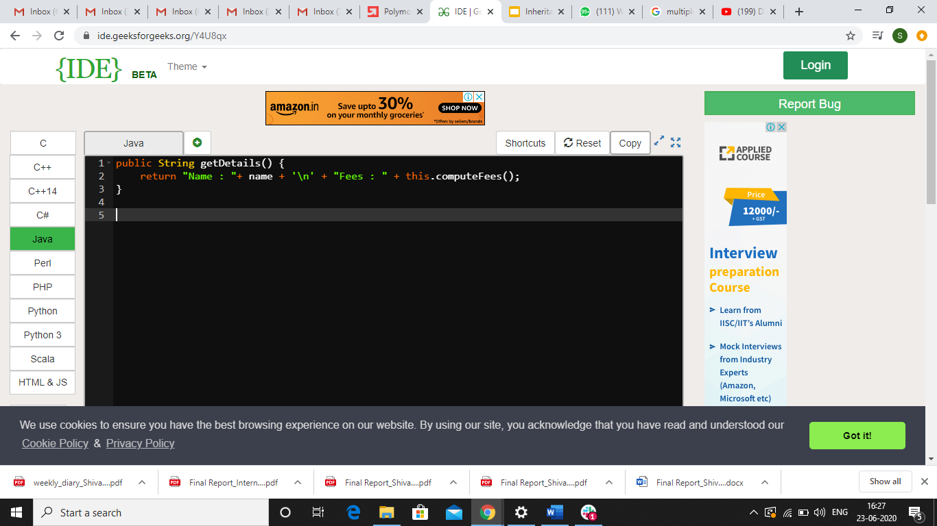
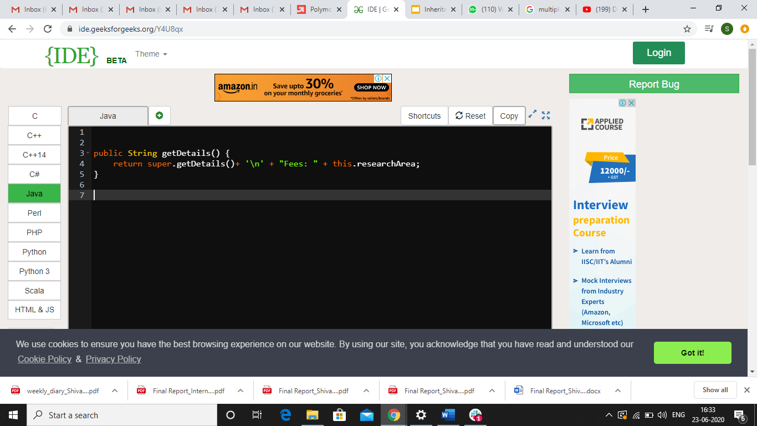
Method Overriding
getDetails() method for Student Class
getDetails() method for ResearchStudent Class

Slide 23

Method Overriding: Considerations
Considerations while overriding a method:
The method name, the return type, and the argument list of the overriding method in the subclass
should match the method of the superclass.
The access modifier of the method in the
subclass cannot be more restrictive than the one in the superclass.

Slide 24
Method Overriding: Considerations
This implies that if the method being overridden is declared as public in the superclass, it cannot be declared as private or protected in the subclass.
Methods defined as private, static, or final cannot be overridden.

Slide 25
Method Overriding: Considerations
Note: Whenever a call to the overridden method is made, it is the subclass version of the method that is invoked and not the superclass version.
To call the superclass version of the overridden method, use the ‘super’ keyword along with the method name super.methodName();.

Slide 26
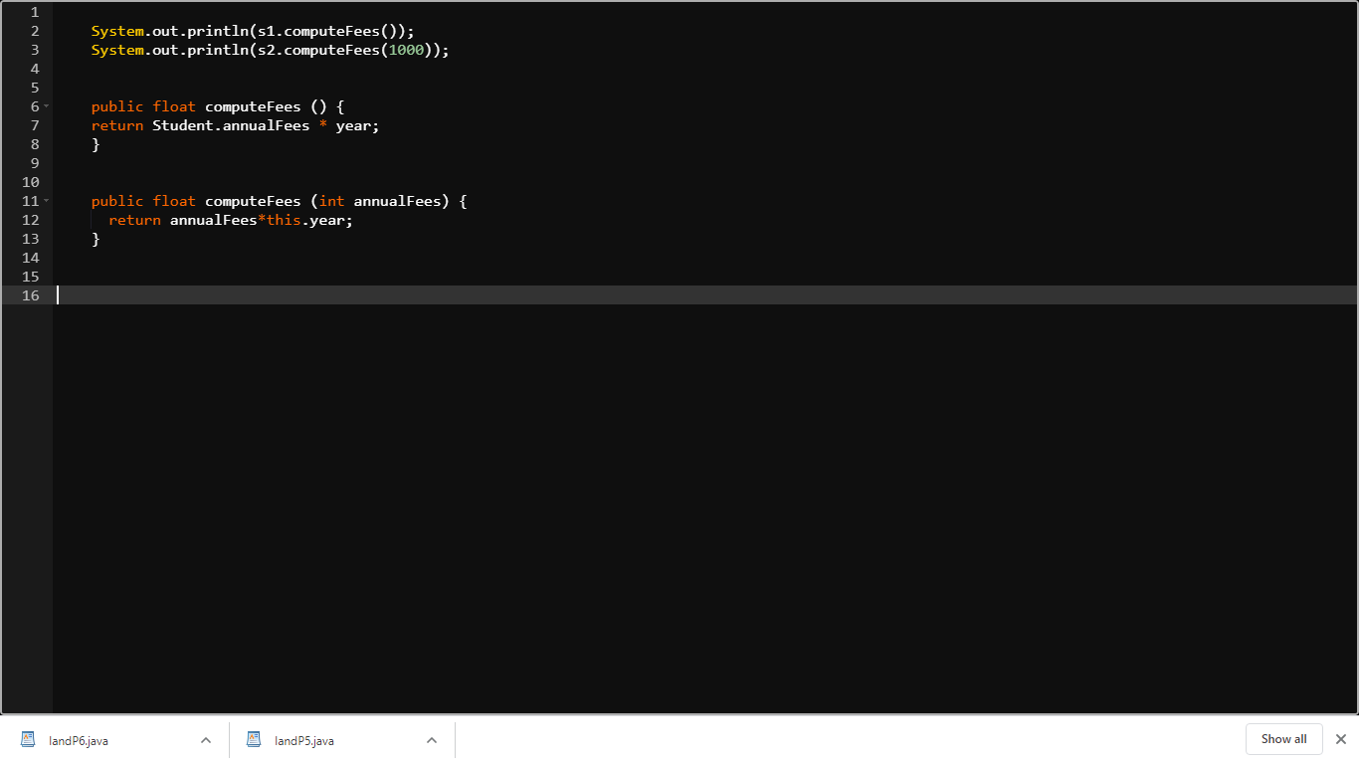
Method Overloading: Introduction Example
Let us take an example. You have
an implementation of the
computeFees() method inside the Student class.
Suppose, you want to have another implementation of computeFees() method where you do not want to use the annualFees attribute that applies to all Students. Instead, you want an annualFees attribute that may apply to only some selected category of Students.

Slide 27
Method Overloading: Introduction Example
However, you want the name and definition of the method to be same. Can you do that?
Well, yes this can be done. You’ll just have to create another method with the same name and return type.
The only difference will be that you’ll pass an attribute annualFees as an argument and the method will use that attribute instead of the global annualFees attribute.

Slide 28

Method Overloading: Introduction Example
But now, you have created two methods of the same name inside the same class. Won’t there be a name clash which will lead to some error?
Well, no. There won’t be any error in this
program. This is because of the
phenomena in Java known as Method
Overloading.

Slide 29

Method Overloading
Method Overloading
It refers to two or more functions/methods having same name and either same or different return type.
Eg. public int computeFees(int fees)
public int computeFees()
OR
public int abc(int a)
public float abc()

Slide 30

Method Overloading
Two ways to overload a function:
Change the number of arguments.
Change the data type of arguments.
Eg. public float computeFees(float fees)
public float computeFees(int fees)
public float computeFees(float fees, int percent)

Slide 31
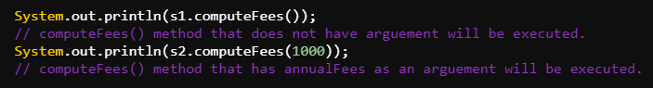
Method Overloading
So, in Java, these methods will be considered as completely different methods by the compiler.
The compiler is in perfect position to distinguish between these methods based on the parameter list that will be used while calling these methods.

Slide 32
Method Overloading
Two important considerations while using method overloading are:
The return type of a method may or may not be different.
The parameter list MUST be different (either lengthwise or datatype wise) for each version of a method in a class.
Having the same parameter list but a different return type for a method will result in a compilation error.

Slide 33
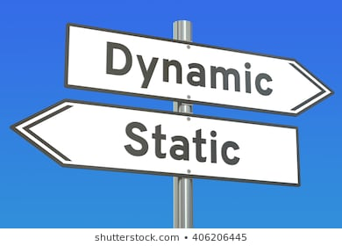
Types of Polymorphism
Types of Polymorphism
Static
Dynamic

Slide 34

Static Polymorphism
Static Polymorphism
It is a type of polymorphism in which compiler is aware which version of the overloaded function is to be invoked. Therefore, it is also known as compile time polymorphism. So,
this method overloading is a static polymorphism.
The compile judges which method has to be called
based on the parameters that are passed while calling the method.

Slide 35
Static Polymorphism
Like, in our example, the first implementation of computeFees() was called when no parameter was passed while calling it and second implementation was called when a parameter was passed while calling it.
Thus, this type of polymorphism is such that the distinction between the two methods is done at compile time or static time. Hence, it is called Static Polymorphism.
Notes:
https://learn.upgrad.com/v/course/439/session/39521/segment/211850
Another example of method overloading can be shown

Slide 36

Introduction to Dynamic Polymorphism
You have already been introduced to one type of polymorphism i.e static polymorphism which is implemented using function overloading.
Now, it’s time to see the other type of
polymorphism i.e Dynamic Polymorphism.

Slide 37
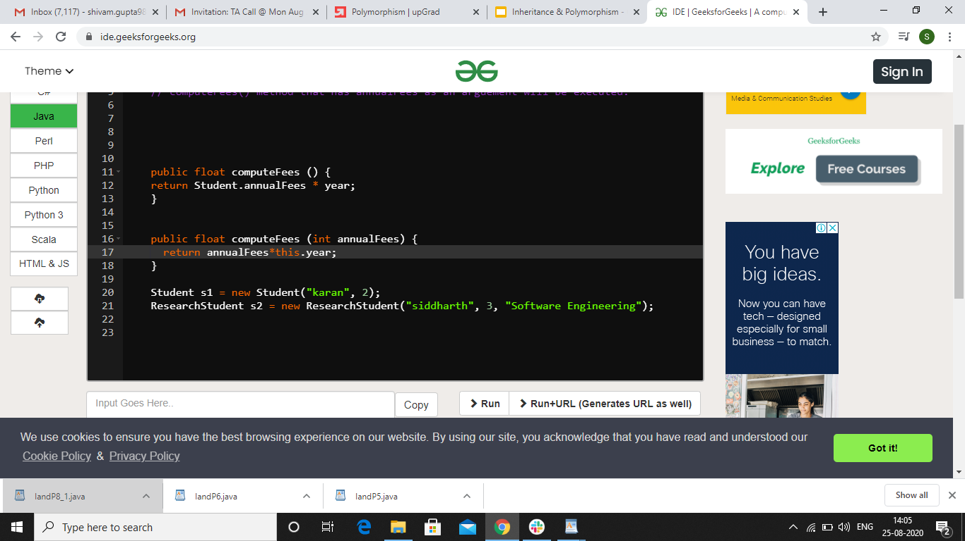
Introduction to Dynamic Polymorphism
Let’s see the code example to understand dynamic programming.
Here, s1 is assigned an object of type Student and s1 itself is of the type Student. Similarly, s2 is assigned an object of type ResearchStudent and s2 itself is of the type ResearchStudent.

Slide 38

Introduction to Dynamic Polymorphism
You have been told that it is not allowed to create an object of some type which has a reference of some other type.
Can we declare an object of ResearchStudent class which has a reference of Student class? Will it be a violation
of the above statement?
Well, no it will not be a violation.

Slide 39

Introduction to Dynamic Polymorphism
s2 has been assigned an object of the type ResearchStudent but it itself has the reference of Student class. You will observe that this will not give any error.
This is because of the last concept of the OOP called Dynamic Polymorphism.

Slide 40
Dynamic Polymorphism
Dynamic Polymorphism
The concept of Dynamic Polymorphism in Object Oriented Programming allows us to assign objects of subclasses to references of superclasses.
Student is a superclass of ResearchStudent and therefore any reference of Student class is allowed to point to any object of ResearchStudent class.

Slide 41
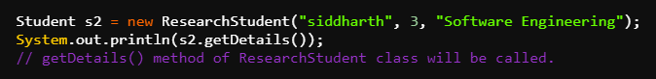
Dynamic Polymorphism
Now, if you try to call the getDetails() method using s2, you’ll observe that the getDetails() method of the subclass has been invoked. Even though s2 has a reference of Student class but getDetails() method of ResearchStudent class will be called.
This is basically what Dynamic Polymorphism actually is.

Slide 42
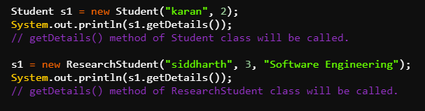
Dynamic Polymorphism
Also, it is not necessary to create a new reference. You have s1 as a reference to Student class which is also pointing to an object of
Student class.
Now, if you
make s1 point
to an object of ResearchStudent class, it will again be dynamic polymorphism and getDetails() method of ResearchStudent will be called.

Slide 43

Dynamic Polymorphism
This proves that even though same reference is been used to call the getDetails() method but the actual implementation of the method depends upon the object to which s1 is pointing.

Slide 44
Characteristics of Dynamic Polymorphism
Characteristics of Dynamic Programming
It is one of the most important property of OOPs.
It helps to create flexible and extensible programs.
It is also known as Dynamic Binding as well as Run time Polymorphism.
It is implemented using method overriding.
Notes:
https://learn.upgrad.com/v/course/439/session/39521/segment/211851
Difference between compile time and run time can be shown.

Slide 45

Dynamic Polymorphism: Example
So, now you have seen what dynamic polymorphism is and how it can be implemented using method overriding. But, what is the need to do so? How is dynamic programming proving helpful in our code?
Let us see find out the need of dynamic
programming using the code example.

Slide 46
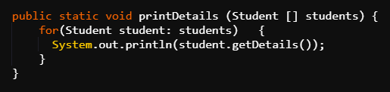
Dynamic Polymorphism: Example
Suppose, you want to have a utility function called printDetails() method in the main method that takes an array of Students as parameter and print their details.
The printDetails() method goes through a for loop and iterates over the array and print the details of each of the Students which are the elements of this array.

Slide 47
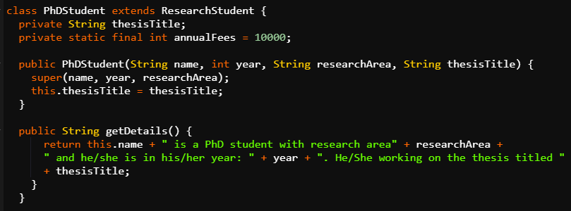
Dynamic Polymorphism: Example
Also, you have a PhdStudent class which is a subclass of ResearchStudent class.

Slide 48

Dynamic Polymorphism: Example
There is an instance of PhdStudent class which you named as s3.
There is one assumption here in this example. The printdetails() method was created before the addition of ResearchStudent class and PhdStudent class in the code.
The person who implemented the printDetails() method had no idea that there will be a ResearchStudent and PhdStudent class in future.

Slide 49

Dynamic Polymorphism: Example
So, this method is made to call the getDetails() function of the Student class. Now, you create an array named array of type Student in the main method and add s1, s2 & s3 to it.
s1, is of the type Student, s2 is of the type ResearchStudent and s3 is of the type PhdStudent.

Slide 50
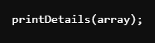
Dynamic Polymorphism: Example
Now, when you call the printDetails() method, you observe that the code works fine and the details of all the three students are printed.
s1 called the getDetails() method of Student class, s2 called the getDetails() method of ResearchStudent class and s3 called the getDetails() method of PhdStudent class.

Slide 51

Dynamic Polymorphism: Example
The catch here is that printDetails() was a method which was created before the ResearchStudent and PhdStudent class were created but still it was able to work perfectly well with the getDetails() method of these classes.
This means that as long as it is trying to call the
getDetails() method of any of the subclasses of
Student, there is no problem.

Slide 52

Dynamic Polymorphism: Example
So, you can see that Dynamic Polymorphism is at play and it is allowing you to choose the right version of the getDetails() method.

Slide 53

Dynamic Polymorphism: Detailed Concept
Now, if you need to use Dynamic Polymorphism in a powerful way, you need to understand a subtle point about it.
The point is that what happens when a call to
overriding method of a subclass happens not
from outside the class but from another method
implemented in the superclass?

Slide 54

Dynamic Polymorphism: Detailed Concept
Let’s get back to the code to understand this. There are some changes in the code: no PhdStudent class and its instances, no getDetails() method in the
ResearchStudent class.
Now, the getDetails() method is only present in Student class. So, the object of ResearchStudent class will also invoke the getDetails() method from the Student class because ResearchStudent is a subclass of Student class.

Slide 55
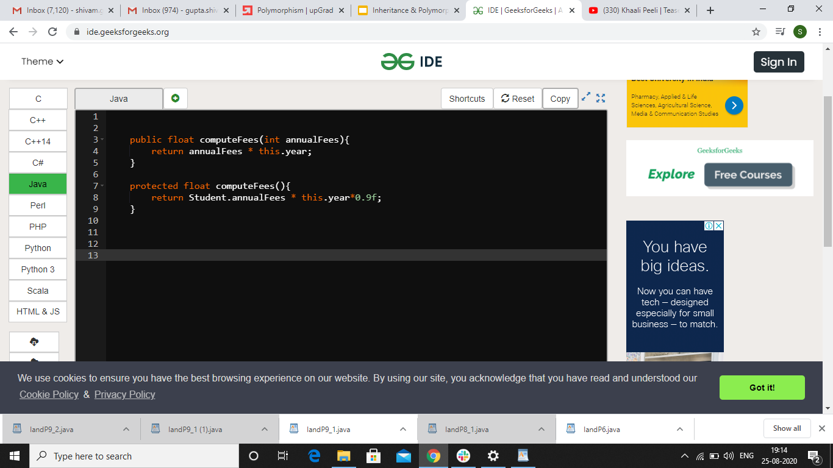
Dynamic Polymorphism: Detailed Concept
Now, inside the getDetails()
method of the student class,
there is a call to the computeFees() method of the Student class.
Now, you override this computeFees() method to the ResearchStudent class and
provide a new definition to it
giving 10% rebate in the fees.
Note: annualFees attribute has to be declared as protected instead of private so that there is no error.

Slide 56

Dynamic Polymorphism: Detailed Concept
Now, there are two computeFees() method and you know that according to the definition of getDetails() method, computeFees() will be called whenever the
getDetails() will be called.
So, the question here is that if you’ll call the
getDetails() method from an instance of
ResearchStudent class, which computeFees() method will be called?

Slide 57
Dynamic Polymorphism: Detailed Concept
The answer is that the computeFees() method of ResearchStudent class will be called. This is because dynamic polymorphism is not just effective at the first level of function call, rather, it is effective at any level depth of function calls.
This means even if overriding function is called from within some other method defined inside the superclass, still, always the overridden version of the function will be called.

Slide 58
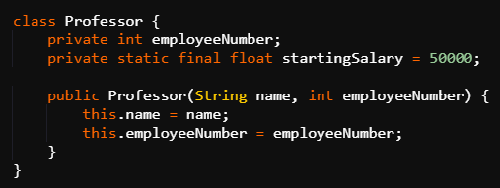
Need for Abstract Classes
Suppose, you want to add information about Professor in your code. So, you can add a
Professor class into your
program. It can have
attribute name,
startingSalary and
employeeNumber. Now, it resembles the Student class because also has got a common attribute called name.

Slide 59
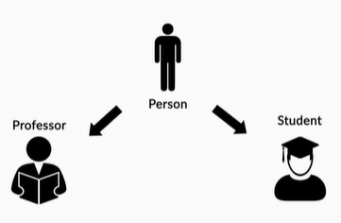
Need for Abstract Classes
Also, you would want to print the details of both Students and Professors in one go.
In inheritance, you must have
learned that as soon as there is
some commonality between two
classes, it should be captured using
the principles of inheritance. So, here, you can observe that Student and Professor are basically two types of Person.

Slide 60

Need for Abstract Classes
Therefore, you must have a super class above these two classes named Person class. So, you must make the Student & Professor class extend the Person class.
Since, name is a common attribute in
both the classes, so it can be removed
from both the classes and added in the Person class. You can have a constructor for the Person class to initialize the name attribute.

Slide 61
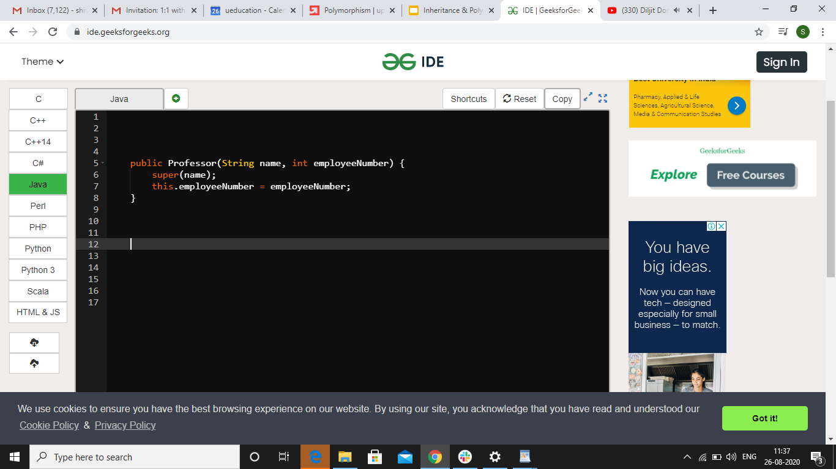
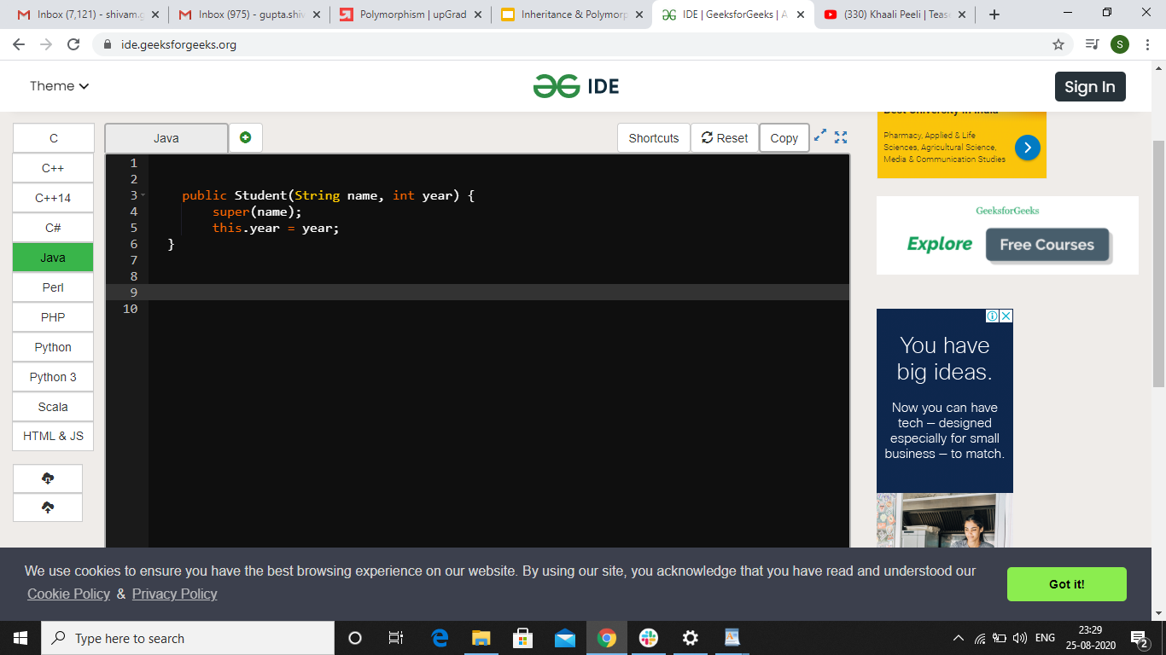
Need for Abstract Classes
Parallely, you can make changes for the name initialization in the constructor of the Student & Professor class using the super keyword.

Slide 62

Need for Abstract Classes
Now, you can create a printDetails() method inside the Main class. It resembles the printDetails() method you created earlier. The only difference is that this works on an array of Person and not Student.

Slide 63
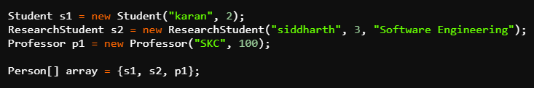
Need for Abstract Classes
Now, inside the main method you can have instances of Student class, ResearchStudent class and Professor class say s1, s2 and p1 respectively.
You can create an array of type Person and add instances s1, s2 and p1 to it. This array can be passed as a parameter to the printdetails() function.

Slide 64
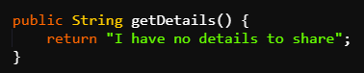
Need for Abstract Classes
Now, inside the printDetails() method, there is an issue in calling the getDetails() method. This is because although there is a getDetails() method inside the Student class but there is no getDetails() method in Person class. How can you solve this issue?
One solution is to provide some
kind of a dummy getDetails()
method inside Person class.

Slide 65

Need for Abstract Classes
Now, after the passing the array to printDetails() function, when the code is run, you’ll observe that
the getdetails() method of Student,
ResearchStudent and Person gets called.
Details are printed for the first two students but dummy method gets called for the Professor. This happened because there was no getDetails() method inside the Professor class and hence the dummy getDetails() method of the superclass Person accidentally got called instead.

Slide 66
Need for Abstract Classes
So, implementing a dummy getDetails() method just because the Person class need to have a getDetails() function is not the correct solution. You actually needed a getDetails() method for the Professor class and instead the dummy one got called which was just created to satisfy the compiler.
So, what you actually need is a way to make the compiler accept the fact that there is no implementation of getDetails() method in the Person class but it still has to be there.

Slide 67

Need for Abstract Classes
Before this, you must first correct your mistake and create a getDetails() method inside the Professor class. You can have a call to computeSalary() method instead of computeFees() method inside this getDetails() method.

Slide 68

Need for Abstract Classes
Now, after defining this getDetails() method in the Professor class, the details will be printed correctly. But, this is not completely right.
Suppose, you create another subclass of
Person and forget to define getDetails()
method in that class. Then, again dummy
method will be called which is not right. So,
you still need a solution.

Slide 69

Introduction to Abstract Classes
After studying the previous code example, you must realise that the real culprit of the problem is not really the non implementation of a particular method in subclass but rather the implementation of a dummy method in the superclass.
But can you remove the dummy getDetails()
method from the Person class? Well, in the
current scenario, it will result in an error.

Slide 70

Introduction to Abstract Classes
So what to do?
Java provides a very nice and elegant solution
of this problem of providing a dummy
implementation in superclass and forgetting
the implementation in subclass.
The solution is abstract classes.

Slide 71
Abstract Classes
Abstract Class
Abstract Classes are partially implemented classes. It has some concrete methods and some abstract methods. Concrete methods are the methods that are completely defined whereas abstract methods are the methods that have a declaration but no definition.

Slide 72
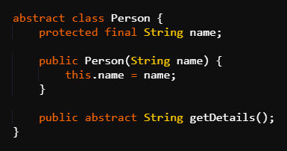
Abstract Classes
Now, you can remove the dummy getDetails() method and solve your problem by having getDetails() method in the Person class as abstract part of the
Person class.
Instead of providing a definition, you
can just declare the getDetails() method and end the declaration with a semicolon.

Slide 73

Abstract Classes
So, when you declare this getDetails() method as abstract method, you can observe that you will encounter no error when you run this program.
Now, let us check what happens if you forget
to add the getDetails() method in the Professor
class. In this case, you will observe an error
stating “class Professor must either be declared as abstract or implement abstract method getDetails() in Person”.

Slide 74

Characteristics of Abstract Classes
Let us see the characteristics of Abstract Classes to understand this error statement.
Abstract class can be implemented by both abstract as well as non abstract class.
Either the abstract method of an
abstract class has to be defined in
its subclass or the subclass also has to be declared as abstract.

Slide 75

Characteristics of Abstract Classes
Also, you cannot create an instance for a class which has been declared as abstract.
For eg: In the code, if you’ll declare Professor as
an abstract class, you’ll observe an error in the
statement where you created the instance of
the Professor class.
Abstract classes can be instantiated only by its non abstract subclasses.

Slide 76
Characteristics of Abstract Classes
The only way to declare a subclass as a non abstract class is by actually providing implementation of all the abstract methods of the superclass in the subclass.
An abstract class may or may not have abstract methods. You do not need to have only abstract methods in an abstract class. You can have non-abstract methods in it as well.

Slide 77
Characteristics of Abstract Classes
An abstract method should not be final.
The whole purpose of declaring an abstract method is that the method can be used later in a subclass.
You know that a final method cannot be overridden. So, if you define an abstract method as final, you will not be able to override it in any subclass.
This defeats the purpose of declaring a method an abstract one in the first place.

Slide 78
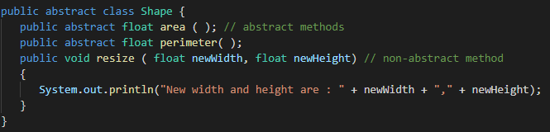
Abstract Classes: Example
It is important to note that you do not need to have only abstract methods in an abstract class. You can have non-abstract methods in it as well. So, in order to declare the Shape class as abstract, the syntax is as follows:

Slide 79
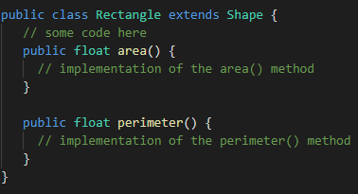
Abstract Classes: Example
It is important to note that you cannot create instances of an abstract class. You can only inherit from an abstract class. Therefore, in order to use the abstract class Shape, the Rectangle class can extend it as follows:

Slide 80
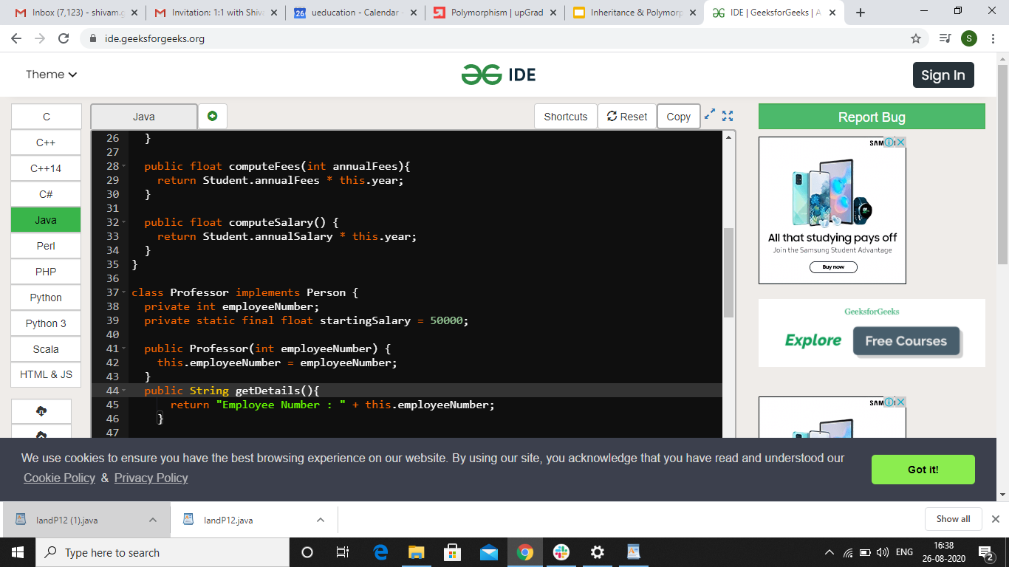
Interface
Now, it’s time to get introduced to the last topic i.e interface.
Let us try to understand the topic using the same code. Before starting, you must know certain changes that have been made to the code:
name attribute has been removed from all the classes. Instead, Professor has an
attribute called
employeeNumber.

Slide 81
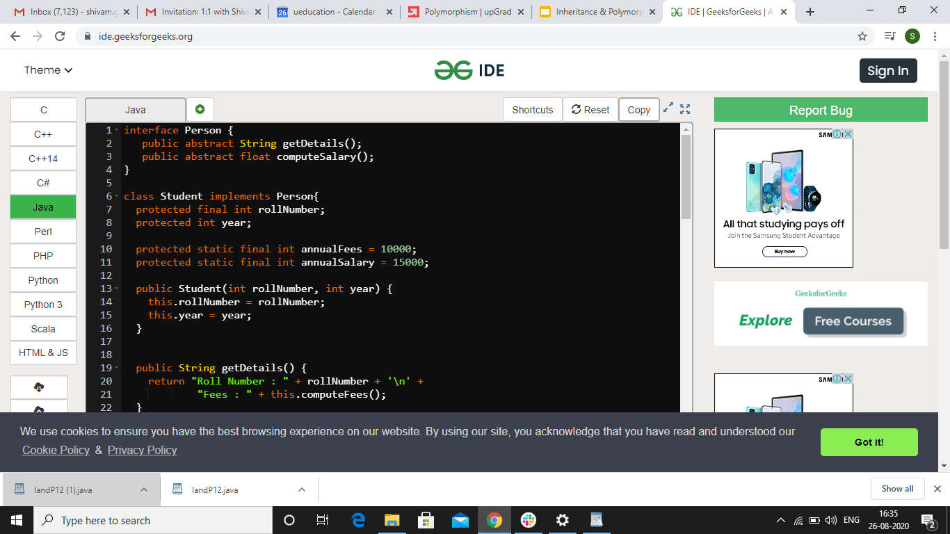
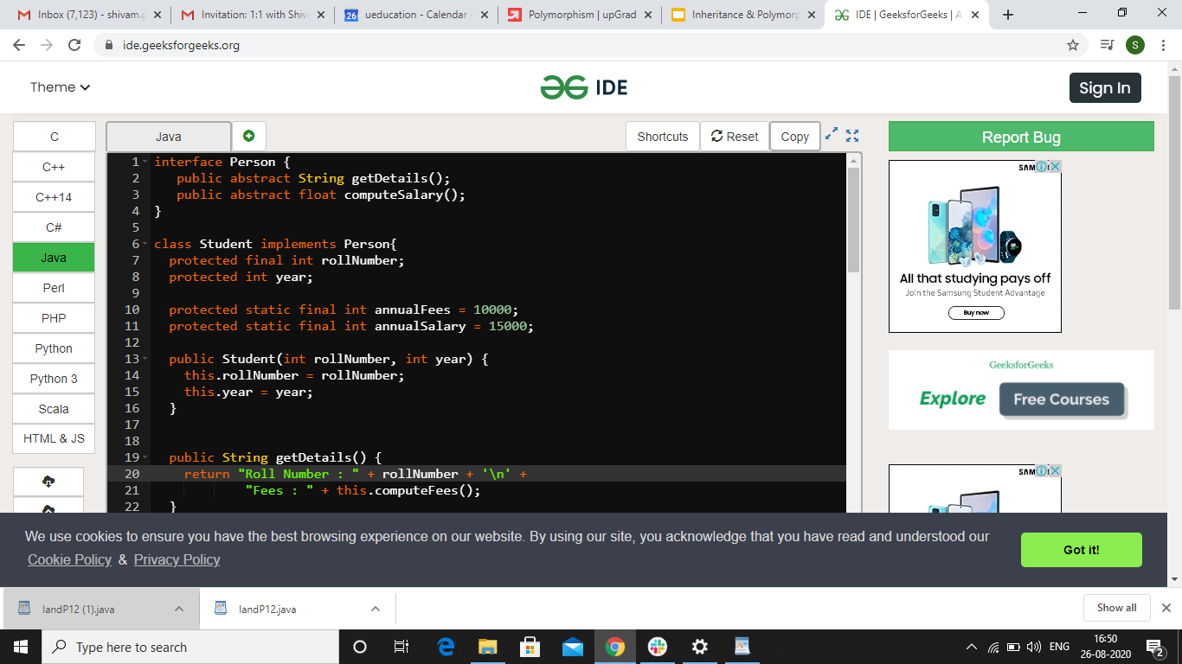
Interface
Student has a new attribute called
rollNumber. Constructors of these
classes are also updated accordingly.
A new global attribute called annualSalary has been introduced for Students who earn scholarship.

Slide 82
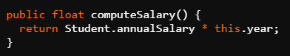
Interface
A computeSalary() method has been added in the Student class and it is computed by the multiplication of the annual fees and year of the student.
Also, note that there was a computeSalary() method already in the Professor class.

Slide 83
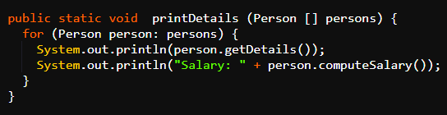
Interface
Apart from printing the details of the Person objects, the printDetails() method in the Main class is now printing salary of the objects also.

Slide 84
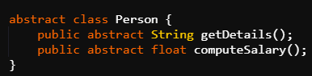
Interface
Person class now have two abstract methods: getDetails() as well as computeSalary(). Person class does not have any more attributes in it.

Slide 85

Interface
Now, the Person class has become a peculiar abstract class i.e a completely abstract class. This is because now it has no concrete parts as name has been removed.
There are only two abstract methods.
Java provides a separate name for these type
of completely abstract classes and that name
is interfaces.
An interface can thus be considered as a pure abstract class as it consists of only abstract methods.

Slide 86
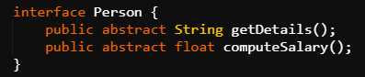
Interface
So, you can change the Person class from an abstract class to an interface. Parallely, you have to change the ‘extends’ keyword to ‘implements’ keyword in all the subclasses.
This is because interfaces are implemented and not extended.

Slide 87

Interfaces vs Abstract Classes
Whenever, you observe that an abstract class has become totally abstract, then it is better to convert them to interfaces.
Let us see in detail the points that must be
kept in mind while choosing between an
interface or an abstract class.

Slide 88
Interfaces vs Abstract Classes
Use abstract class:
If we are sure of the class hierarchy.
If we wish to share some common code amongst classes but also let them have their own implementations of common methods.
When we wish to create multiple instances of a common class.

Slide 89
Interfaces vs Abstract Classes
Use Interface:
When we want the subclasses to implement some mandatory behavior defined in a method.
When we want to implement some characteristics and behavior from multiple sources. This is because it is allowed to implement more than one interfaces in Java.

Slide 90
OOPs Convention
Java programmers often prefer to implement all their classes in their own separate files. This is because classes often are natural boundaries of division of work between developers.
Therefore, it is perfectly meaningful to have every class in its own file and by convention, file is named after the class name and class is declared as public. For eg: Main class will be in file named Main.java and Person interface will be in file Person.java.

Slide 91

OOPs Convention
So, you can have an equivalent implementation of your code by following this convention.
The Main class will be in a file named
Main.java.
Person.java file will contain the public
interface Person.

Slide 92
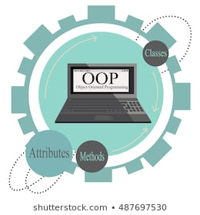
OOPs Convention
Professor.java file will contain the public class Professor which implement Person.
Student. Java file will contain the Student
class.
Finally, ResearchStudent.java file will contain the ResearchStudent class extending the Student class.

Slide 93
Summary
Polymorphism means the ability of a variable, function or object to take on multiple forms.
Method Overriding means defining two or more methods with the same name and same signature. One version of a method in a superclass and the other version in a subclass.
Notes:
https://learn.upgrad.com/v/course/439/session/39521/segment/211850
Another example of method overloading can be shown

Slide 94
Summary
Method overloading refers to two or more functions/methods having same name and either same or different return type.
Static Polymorphism is a type of polymorphism in which compiler is aware which version of the overloaded function is to be invoked.
Notes:
https://learn.upgrad.com/v/course/439/session/39521/segment/211850
Another example of method overloading can be shown

Slide 95
Summary
Dynamic Polymorphism in Object Oriented Programming allows us to assign objects of subclasses to references of superclasses. It is implemented using method overriding.
The purpose of an abstract class is to function as a base for subclasses. They allow you to create functionality that subclasses can implement or override.

Slide 96
Summary
Abstract Classes are partially implemented classes. It has some concrete methods and some abstract methods. Concrete methods are the methods that are completely defined whereas abstract methods are the methods that have a declaration but no definition.
An interface can thus be considered as a pure abstract class as it consists of only abstract methods.

Slide 97
Summary
It is meaningful to have every class in its own file and by convention, file is named after the class name and class is declared as public. For eg: Main class will be in file named Main.java and Person interface will be in file Person.java.

Slide 98

Thank you!
#LifeKoKaroLift

